Slide 1
Lending Club Case Study
Group Members:
Preeti Kharb
Ranga

Slide 2
Business Objective
Company
Context
Company wants to understand the driving factors (or driver variables) behind loan default, i.e. the variables which are strong indicators of default.
Problem statement
Analyse the past applicant data using EDA to help business identify the risky applicants. This will reduce the number of default loans which is the largest source of financial loss.
Company is the largest online loan marketplace, facilitating personal loans, business loans, and financing of medical procedures. Borrowers can easily access lower interest rate loans through a fast online interface.

Slide 3
Dataset: Only contains approved loans.
Analysis Approach
Clean Data
Drop columns with null values
Univariate Analysis
Check distributions and frequencies of various numerical and categorical variables
Segmented Univariate Analysis
Analyse variables against segments of other variables
Drop columns with all random values or single category value
Convert values to proper int, float, date representations
Create derived variables
Create derived variables
Bivariate Analysis
Summarize Results
Do correlation analysis Check how two variables affect each other or a third variable
Publish insights and observations
Analyse joint distributions
Loan
Accepted
Fully Paid
Charged off
Rejected
No transaction history
Current
Customer profile | Action | Risk associated
Likely to pay | Loan declined | Loss of business
not likely to pay | Loan approved | Financial loss

Slide 4
Loan Analysis: Overview
Observation:
Approximately 14% of loans have been charged off.
Company reported a financial loss of 42% in case of charged off loans. Company was only able to recover 58% of the total funded amount in case of charged off.
In case of fully paid loans, Company generated 56M profit through interest.

Slide 5
Loan Amount Analysis
% of charged off loan for each loan amount bucket
Observation:
From the above plots, it is implied that a large number or borrowers took loan of amount less than 15000.
The loan amount distribution is slightly right-skewed with mean greater than the median.
The loan amount trend has a spike around each 5000 boundary.
The percentage of charged off loan increases with the increase in the loan amount.

Slide 6
Income Analysis
Observation:
From the above plots, it is implied that maximum number of loans have been taken by borrowers with annual income less than 50K.
The percentage of charged off loan increase as the annual salary decreases.
So borrowers with less annual income are more likely to default their loans.
This means that loans were approved for the borrowers with lower annual income. The same group resulted in higher number of charged off loans.

Slide 7
Loan Grade Analysis
Observation:
Loans with lower grade have defaulted more compared to higher grade loans. The rate of default increase as we move from higher to lower grade.
Same trend has been observed with interest rates. Company charges higher interest rates for loans with lower grade.

Slide 8
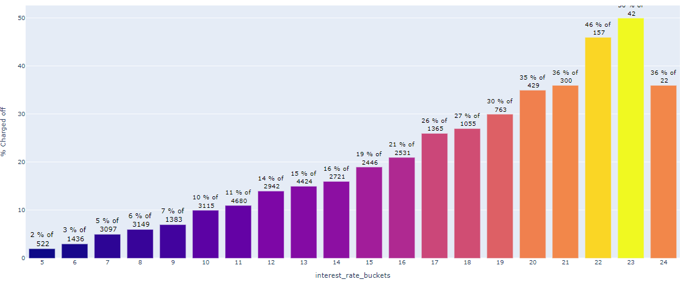
Charged off loans by Interest Rate
Number of charged off loans for each interest bracket.
Observation:
Following on from the previous graphs, Higher interest rate also results in higher default rate.
Loans with interest rate more than 19% has seen higher default rate.
So borrowers are likely to default when they have take loan with interest rate more than 19%.

Slide 9
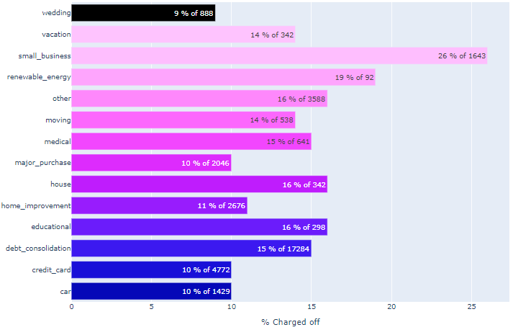
Charged off loans by loan purpose
Number of default loans for different loan purpose
Observation:
Maximum number of loans have been taken for debt consolidation purpose: 17284.
The highest rate of default have been observed by loans taken for small business.

Slide 10
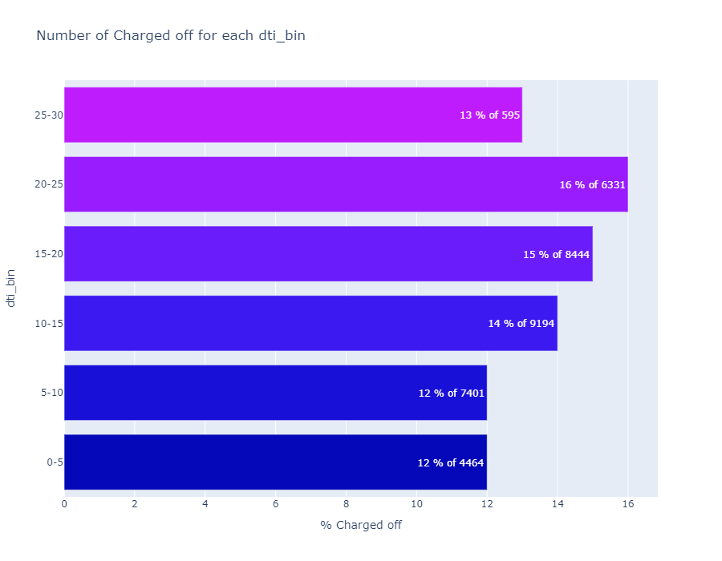
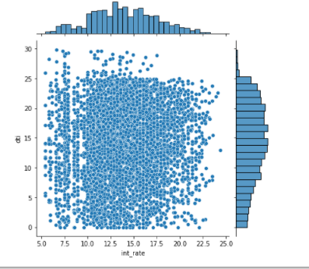
DTI analysis for Charged off loans.
Observation:
Default rate increases with increase in DTI ratio.
The overall interest rate is spread across DTI range. Usually a higher interest rate should be charged against higher DTI to compensate for the risk of charged off.

Slide 11
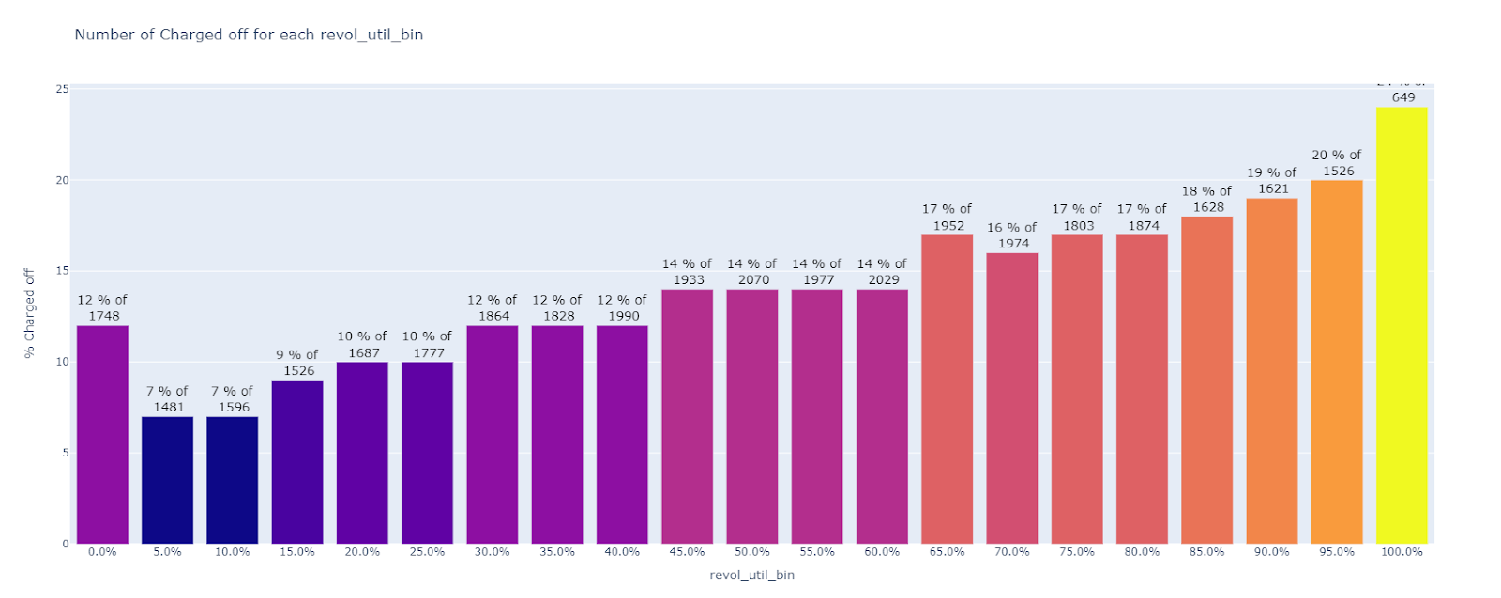
Revolving line utilization analysis for Charged off loans.
Observation:
This is evident from the graph that loans were approved for borrowers with high utilization of revolving line of credit.
This resulted in higher rate of default loans. Borrowers with higher rate of utilization has defaulted more loans when compared to borrowers with low revolving line utilization.

Slide 12
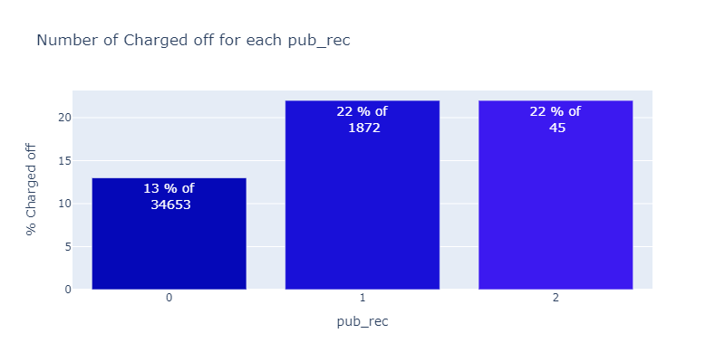
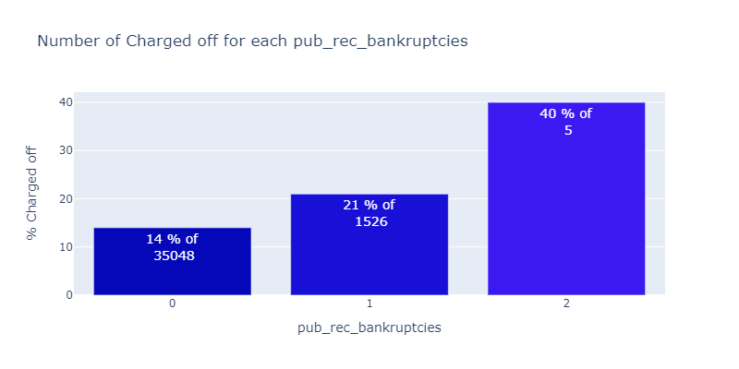
Public record analysis for Charged off loans.
Observation:
1917 Loans were approved for applicants with 1 or more public record. Charged off rate is higher among people with public record when compared to people without a public record.
Similar observation can be made in applicants with previous bankruptcies. 1531 loans were approved for borrowers who have declared one or more more bankruptcies. Charged off rate is higher among these applicants.
Even though the number of approved loans in case of public record and bankruptcies is less than 1%. It still increases the risk of charged off.

Slide 13
Recommendation
Loan amount and borrower’s annual income needs to be considered while approving loans, especially in case where borrower’s annual income is less than 50K and loan amount is more than 15K. Both these variables show a similar trend in case of charged off loans.
Small business loans need to be reduced as they show highest charged off rate.
Currently interest rate is evenly spread across DTI. A higher interest rate should be charged for DTI>20% to compensate for the risk of being charged off.
Loans shouldn’t be approved for borrowers with 65% and more revolving line utilization rate.
Loans shouldn’t be approved for people with one or more public records.

